Slide 1
Complexity Analysis

Slide 2
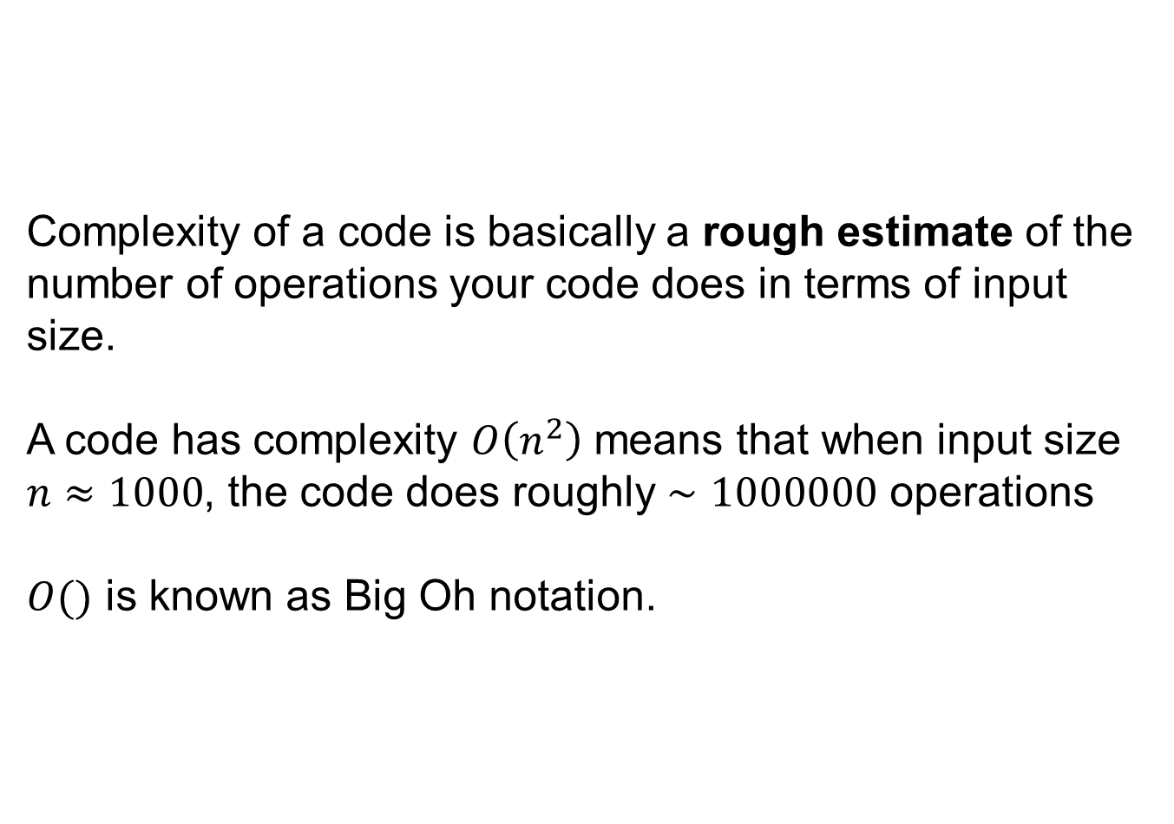
Complexity of a code is basically a rough estimate of the number of operations your code does in terms of input size.
A code has complexity $O\left(n^{2}\right)$ means that when input size $n≈1000$, the code does roughly $∼1000000$ operations
$O()$ is known as Big Oh notation.

Slide 3
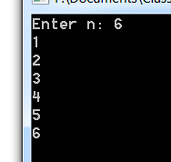
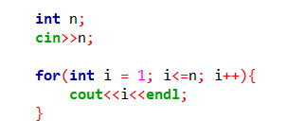
$O(n)$ Example (Linear)

Slide 4
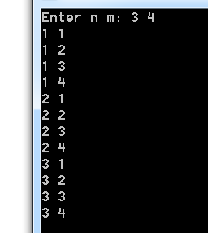
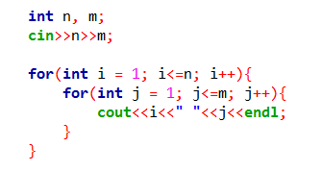
$O(nm)$ Example (Quadratic)
When $n=m,$ this becomes $O(n^{2})$

Slide 5
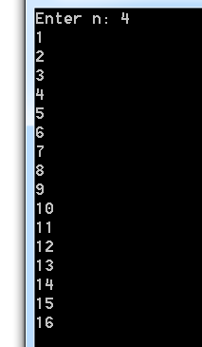
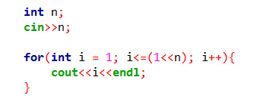

$O(2^{n})$ Example (Exponential)
$$2^{n}$$

Slide 6
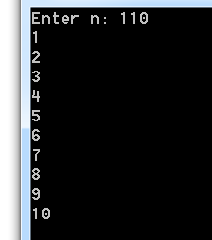
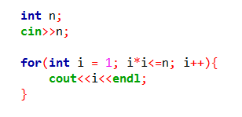
$O(\sqrt{n})$ Example (Square Root)
$$\sqrt{110 }=10.49≈10$$

Slide 7
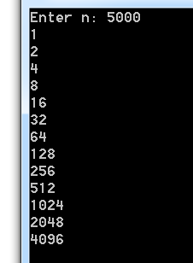
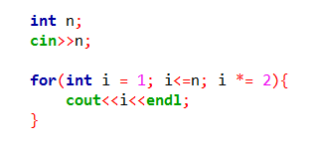
$O(\log{n})$ Example (Logarithmic)
$$\log_{2}{5000=12.28≈13}$$
Note that $O(\log{n})$ has no base

Slide 8
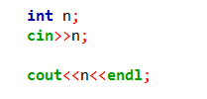

$O(1)$ Example (Constant)

Slide 9
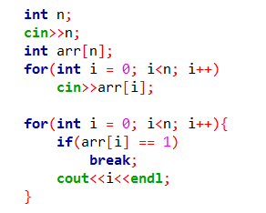
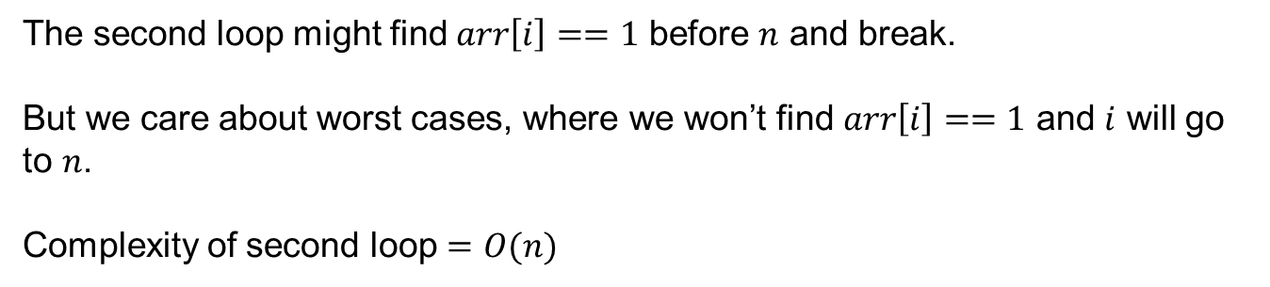
Harder Example – 0
The second loop might find $arr\left[i\right]==1$ before $n$ and break.
But we care about worst cases, where we won’t find $arr\left[i\right]==1$ and $i$ will go to $n$.
Complexity of second loop $=O(n)$

Slide 10
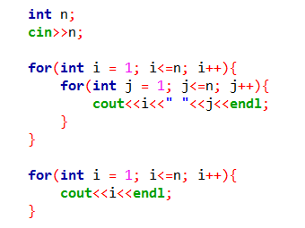

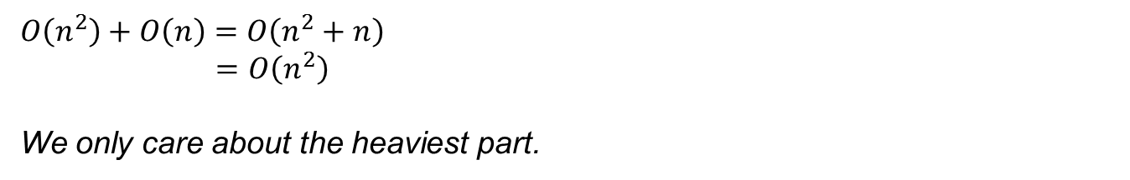

Harder Example - 1
$$O(n^{2})$$
$$O(n)$$
$$O\left(n^{2}\right)+O\left(n\right)=O\left(n^{2}+n\right)$$
$$=O\left(n^{2}\right)$$
We only care about the heaviest part.

Slide 11
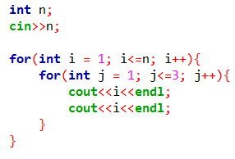
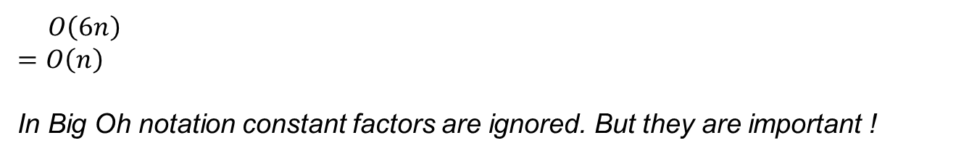
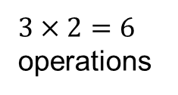
Harder Example - 2
$3×2=6$ operations
$$O\left(6n\right)$$
$$=O\left(n\right)$$
In Big Oh notation constant factors are ignored. But they are important !

Slide 12
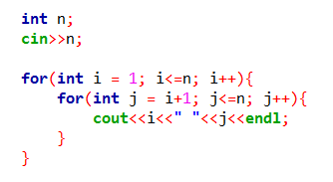
Harder Example - 3
For a fixed $i$ the inner loop iterates $\left(n−i\right)$ times.
Complexity $=\left(n−1\right)+\left(n−2\right)+\left(n−3\right)+…+3+2+1+0=\frac{n(n−1)}{2}$
$$O\left(\frac{n(n−1)}{2}\right)=O\left(\frac{1}{2}n^{2}−\frac{1}{2}n\right)=O\left(\frac{1}{2}n^{2}\right)=O(n^{2})$$

Slide 13
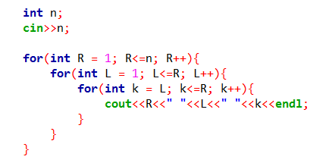

Harder Example - 4
$$O(R^{2})$$
The inner two loops are $O(R^{2})$ (like last example)
Complexity $=1^{2}+2^{2}+…+n^{2}=O(n^{3})$
Again, there’s a hidden $\frac{1}{6}$ constant here.

Slide 14
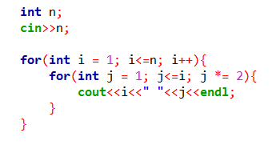

Harder Example - 5
$$O(\log{i)}$$
Complexity $=\log{1}+\log{2}+…+\log{n}$
$$≤\log{n+\log{n+…+\log{n}}}$$
$$=O(n\log{n)}$$

Slide 15
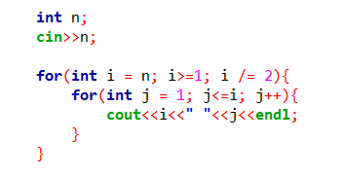
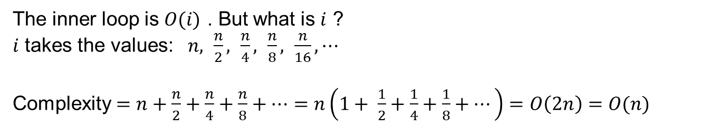
Harder Example - 6
The inner loop is $O(i)$ . But what is $i$ ?
$i$ takes the values: $n, \frac{n}{2}, \frac{n}{4}, \frac{n}{8}, \frac{n}{16}, ⋯$
Complexity $=n+\frac{n}{2}+\frac{n}{4}+\frac{n}{8}+⋯=n\left(1+ \frac{1}{2}+\frac{1}{4}+\frac{1}{8}+⋯\right)=O\left(2n\right)=O(n)$

Slide 16
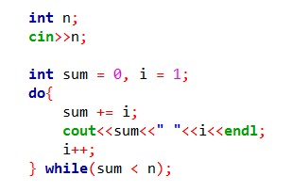
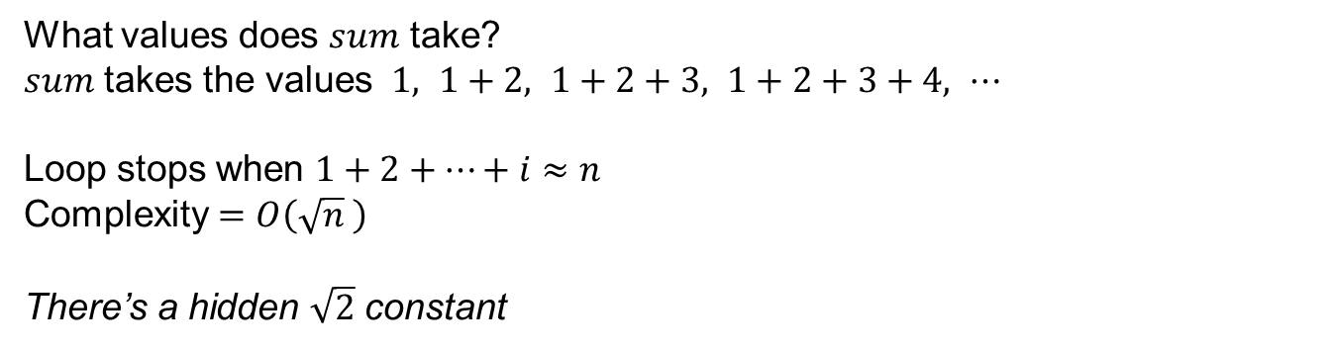

Harder Example - 7
What values does $sum$ take?
$sum$ takes the values $1, 1+2, 1+2+3, 1+2+3+4, ⋯$
Loop stops when $1+2+…+i≈n$
Complexity $=O\left(\sqrt{n} \right)$
There’s a hidden $\sqrt{2}$ constant
$$→O\left(i^{2}\right)≈n$$

Slide 17
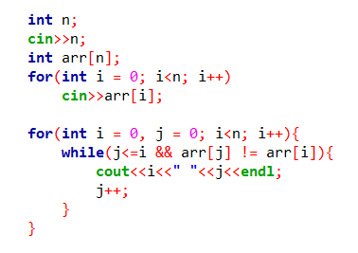
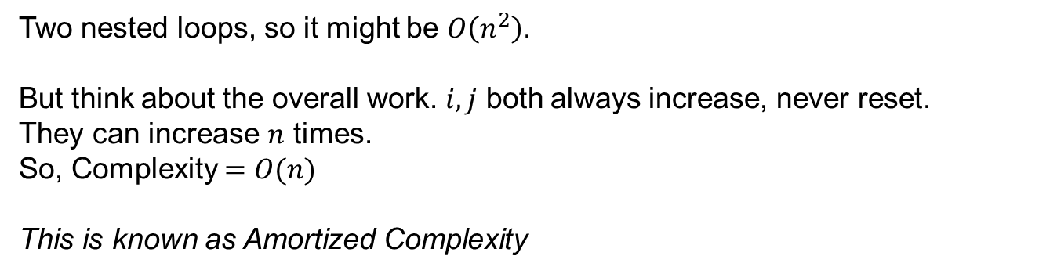
Harder Example - 8
No fixed complexity
Two nested loops, so it might be $O\left(n^{2}\right)$.
But think about the overall work. $i, j$ both always increase, never reset.
They can increase $n$ times.
So, Complexity $=O(n)$
This is known as Amortized Complexity

Slide 18
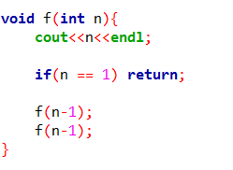
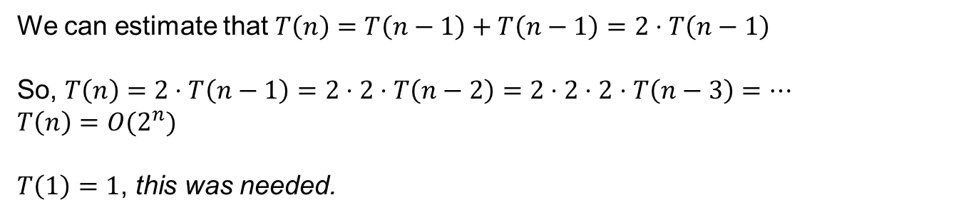



Harder Example - 9
$$T(n)$$
$$T(n−1)$$
$$T(n−1)$$
We can estimate that $T\left(n\right)=T\left(n−1\right)+T\left(n−1\right)=2⋅T\left(n−1\right)$
So, $T\left(n\right)=2⋅T\left(n−1\right)=2⋅2⋅T\left(n−2\right)=2⋅2⋅2⋅T\left(n−3\right)=⋯$
$$T\left(n\right)={O(2}^{n})$$
$T\left(1\right)=1$, this was needed.

Slide 19
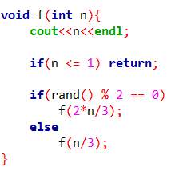
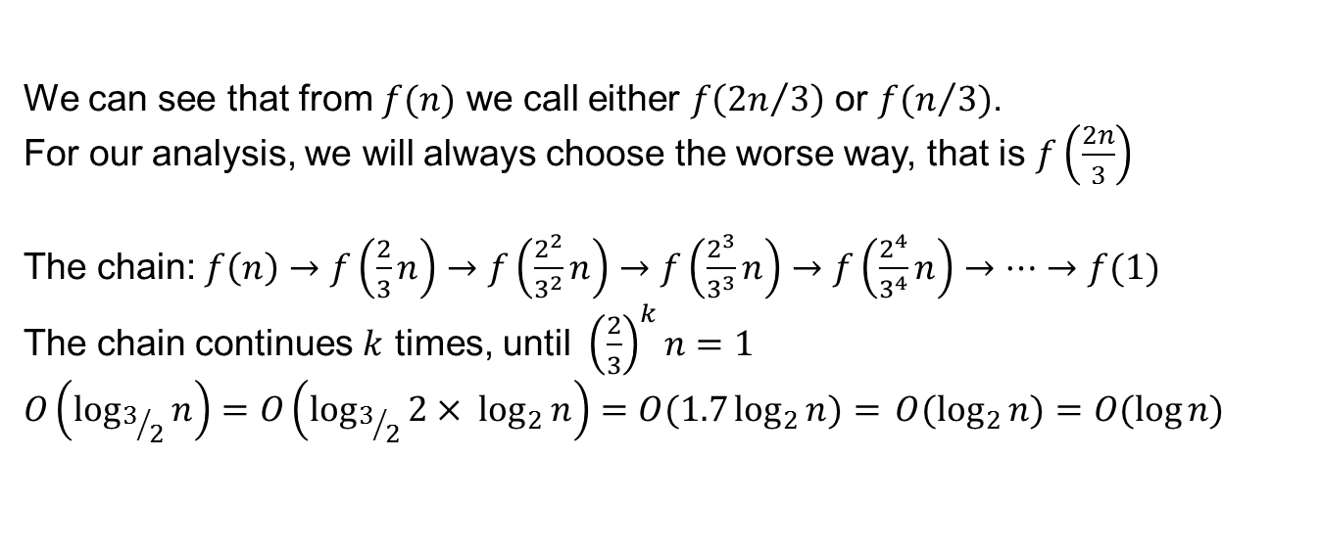
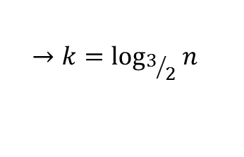
Harder Example - 10
Which branch is
taken?
We can see that from $f(n)$ we call either $f\left({2n}/3\right)$ or $f(n/3)$.
For our analysis, we will always choose the worse way, that is $f\left(\frac{2n}{3}\right)$
The chain: $f\left(n\right)→f\left(\frac{2}{3}n\right)→f\left(\frac{2^{2}}{3^{2}}n\right)→f\left(\frac{2^{3}}{3^{3}}n\right)→f\left(\frac{2^{4}}{3^{4}}n\right)→⋯→f(1)$
The chain continues $k$ times, until ${\left(\frac{2}{3}\right)}^{k}n=1$
$$O\left(\log_{3/2}{n}\right)=O\left({\log_{3/2}{2}× log}_{2}{n}\right)=O(1.7\log_{2}{n)= }O(\log_{2}{n)=O(\log{n)}}$$
$$→k=\log_{3/2}{n}$$

Slide 20
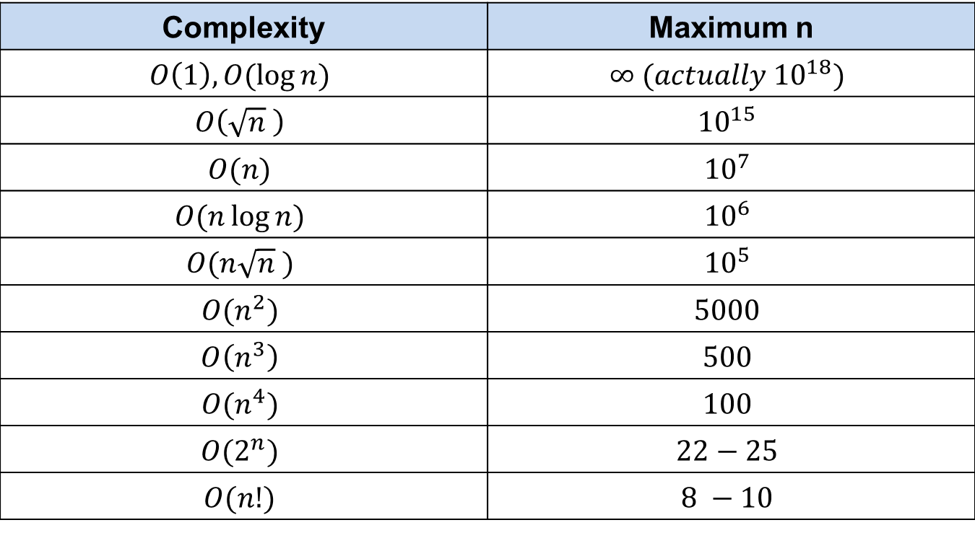
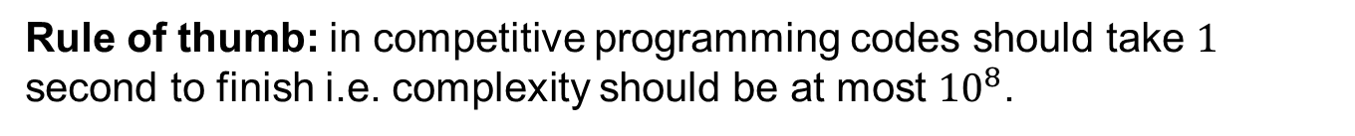
Rule of thumb: in competitive programming codes should take $1$ second to finish i.e. complexity should be at most ${10}^{8}$.
Complexity | Maximum n
$$O\left(1\right), O(\log{n)}$$ | $$∞ (actually {10}^{18})$$
$$O\left(\sqrt{n} \right)$$ | $${10}^{15}$$
$$O(n)$$ | $${10}^{7}$$
$$O(n\log{n)}$$ | $${10}^{6}$$
$$O(n\sqrt{n} )$$ | $${10}^{5}$$
$$O(n^{2})$$ | $$5000$$
$$O\left(n^{3}\right)$$ | $$500$$
$$O(n^{4})$$ | $$100$$
$$O(2^{n})$$ | $$22−25$$
$$O(n!)$$ | $$8 −10$$

